Slide 1
University of Technical Education of Ho Chi Minh City
NETWORKING ESSENTIALS
Chapter 4.
Ethernet and Switch LAN technology
Huynh Nguyen Chinh
Notes:
1

Slide 2
Contents
Understanding Ethernet
Understanding the challenges with Switched LAN Technology
Exploring the packet Delivery Process 1 (layer 1)
Exploring the packet Delivery Process 2 (layer 2)
Exploring the packet Delivery Process 3 (layer 3)

Slide 3
Understanding Ethernet

Slide 4
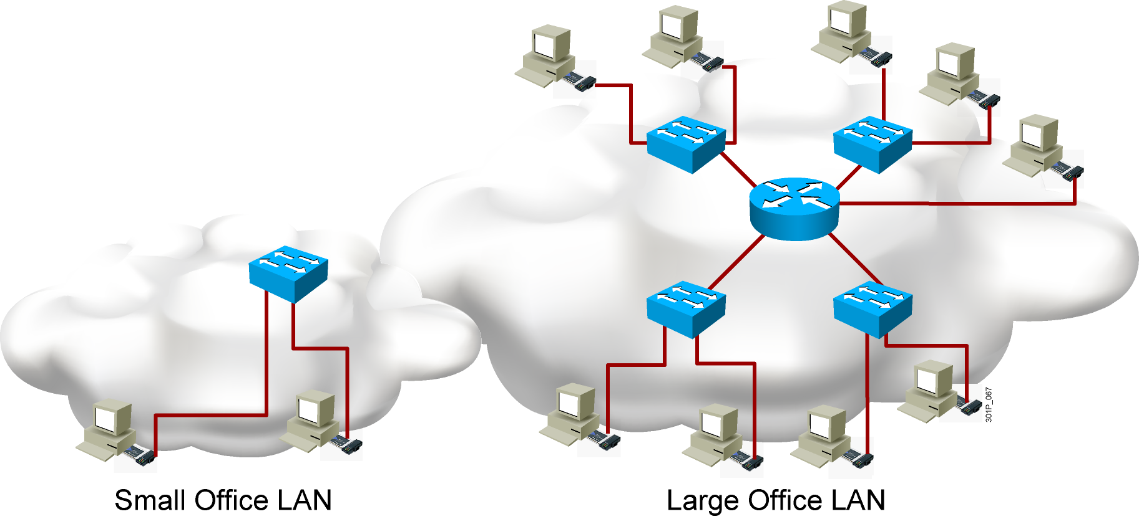
Local Area Network

Slide 5
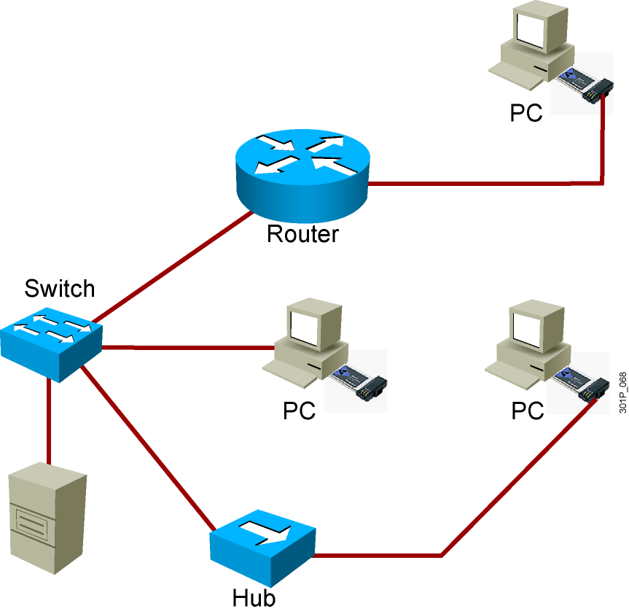
LAN Components
Computers
PCs
Servers
Interconnections
NICs
Media
Network devices
Hubs
Switches
Routers
Protocols
Ethernet
IP
ARP
DHCP

Slide 6
Functions of a LAN
Data and applications
Share resources
Provide communication path to other networks

Slide 7
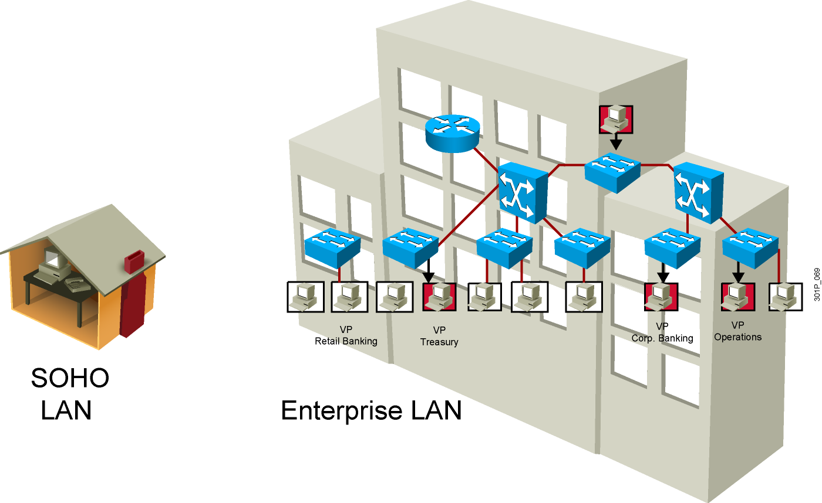
LAN Sizes

Slide 8
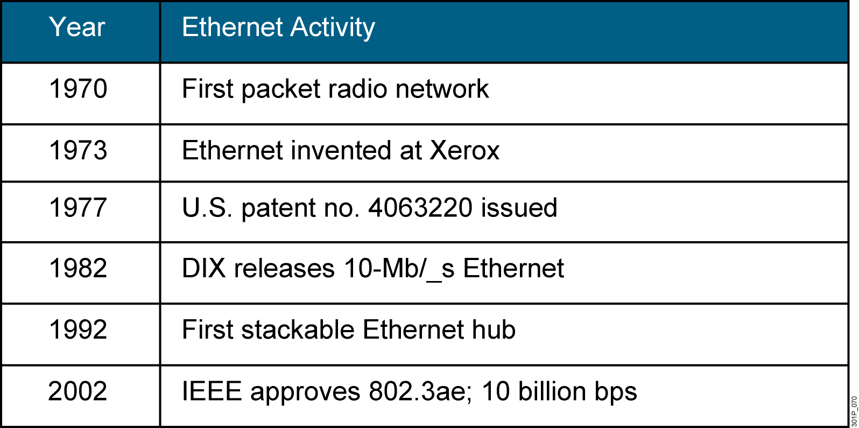
Ethernet Evolution

Slide 9
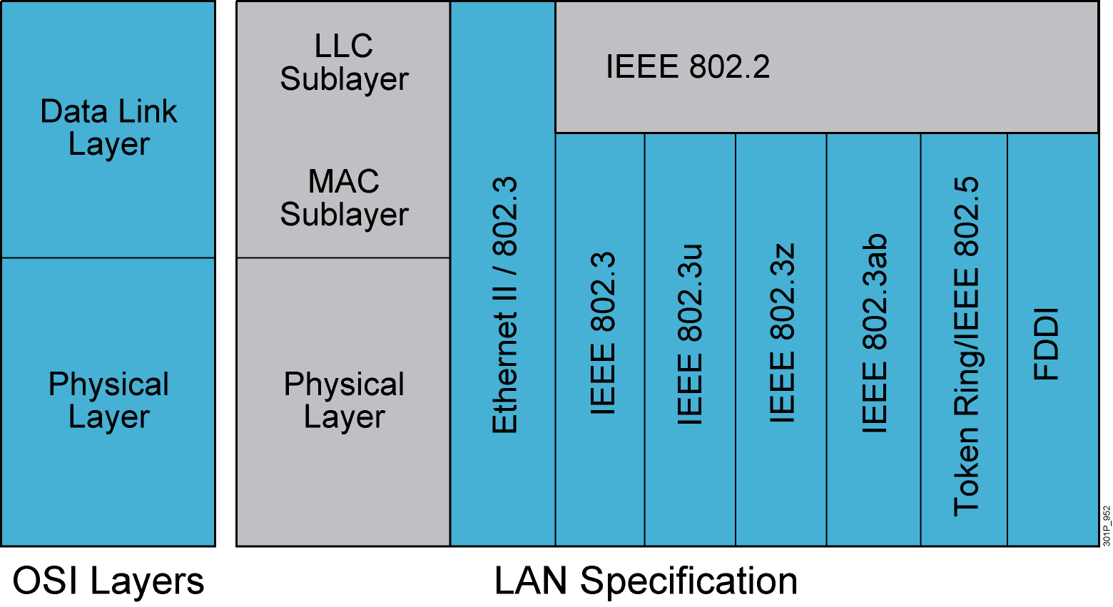
LAN Standards
Notes:
Lesson Aim
<Enter lesson aim here.>

Slide 10
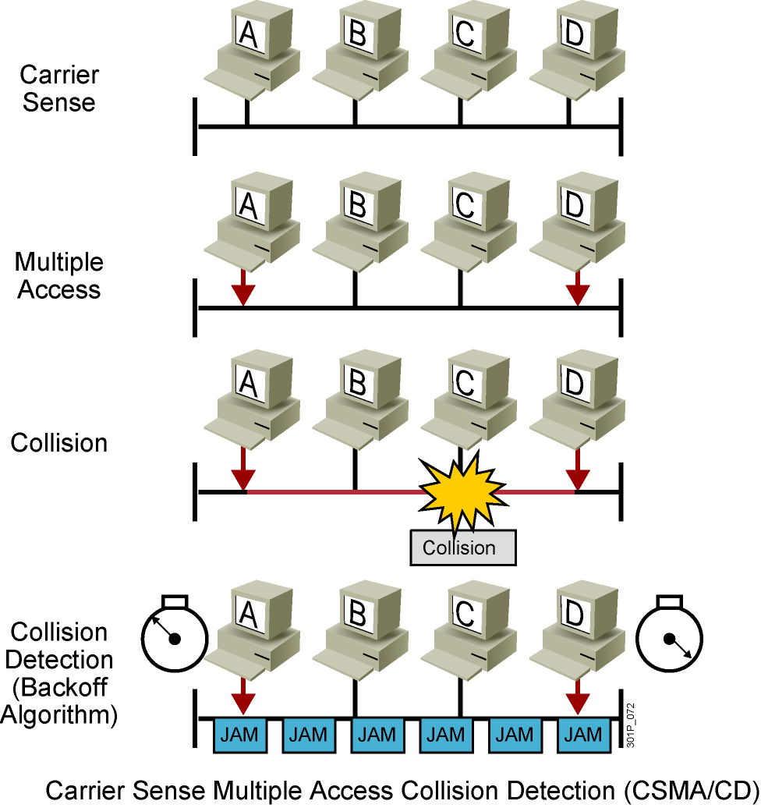
CSMA/CD
Notes:
Lesson Aim
<Enter lesson aim here.>

Slide 11
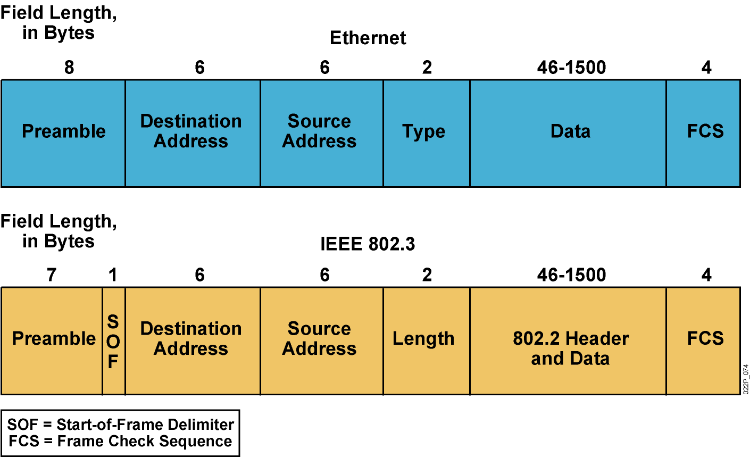
Ethernet Frame Structure

Slide 12
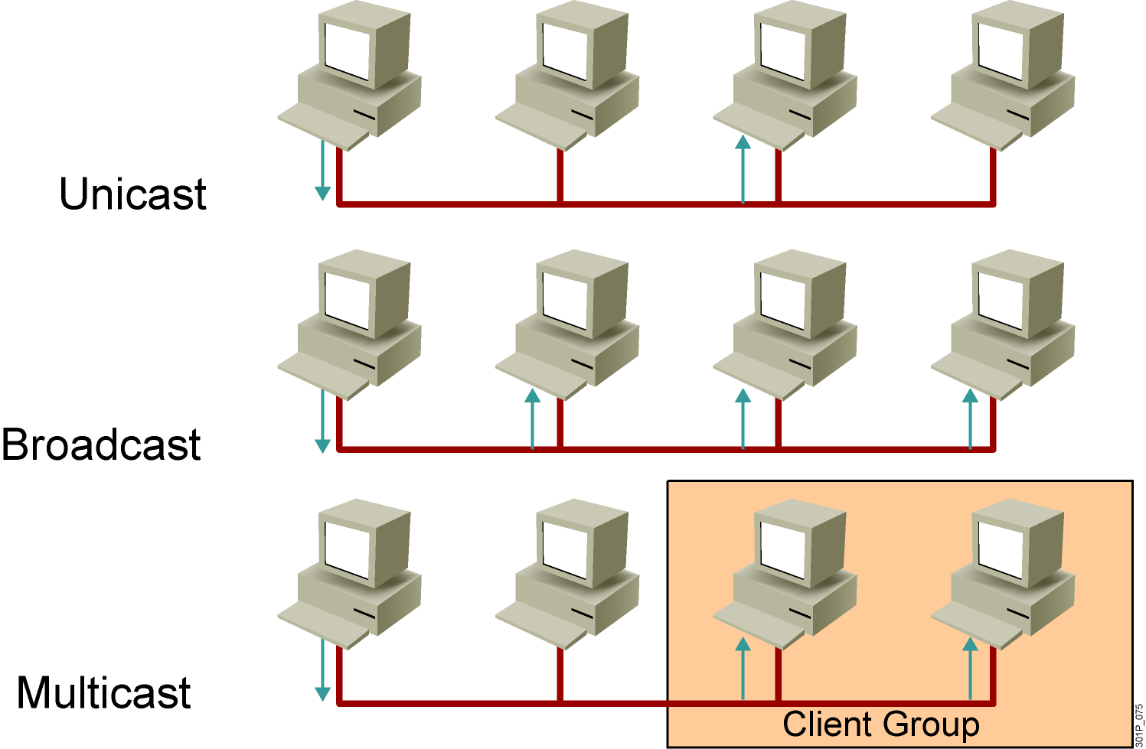
Communicating Within the LAN
Notes:
Lesson Aim
<Enter lesson aim here.>

Slide 13
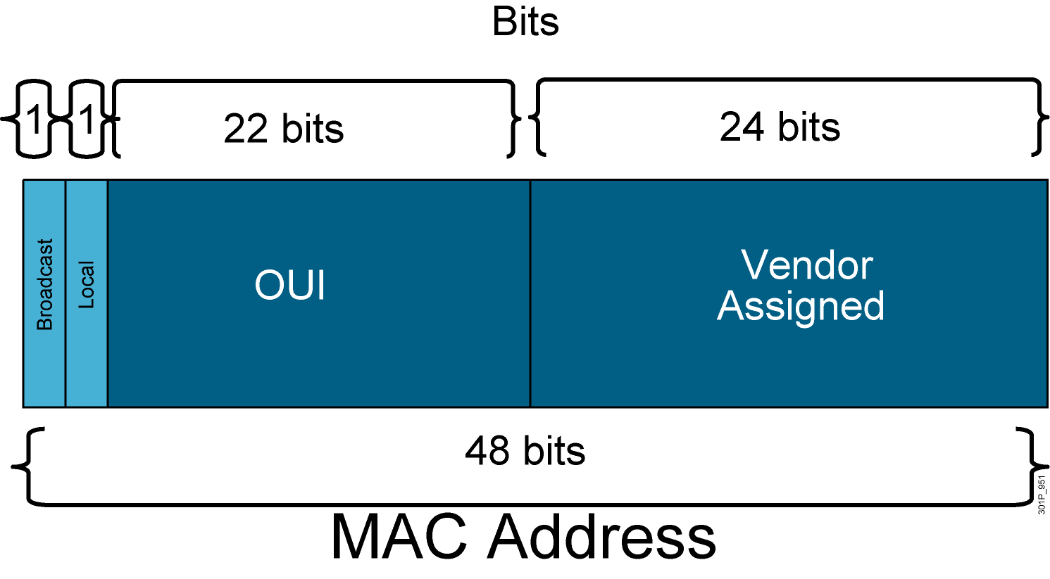
MAC Address Components

Slide 14
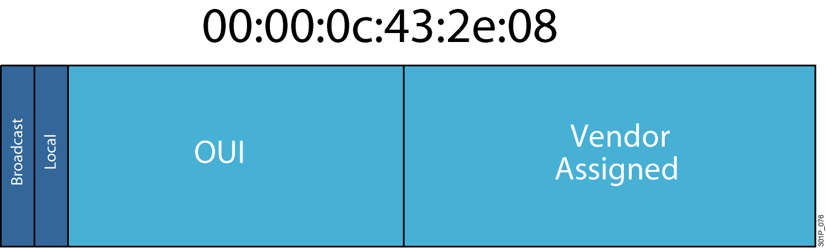
MAC Addresses

Slide 15
II. Understanding the challenges with Switched LAN Technology

Slide 16
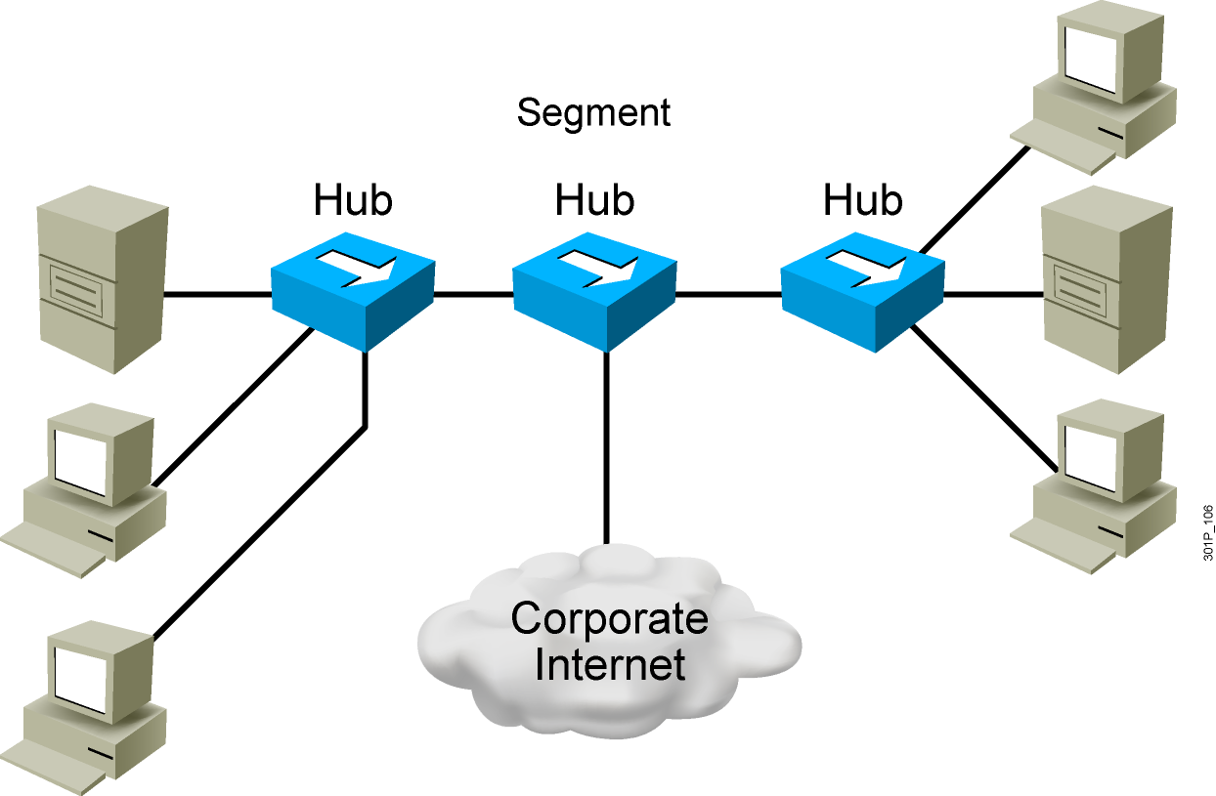
Network Congestion
High-performance PCs
More networked data
Bandwidth-intensive applications
Notes:
Lesson Aim
<Enter lesson aim here.>

Slide 17
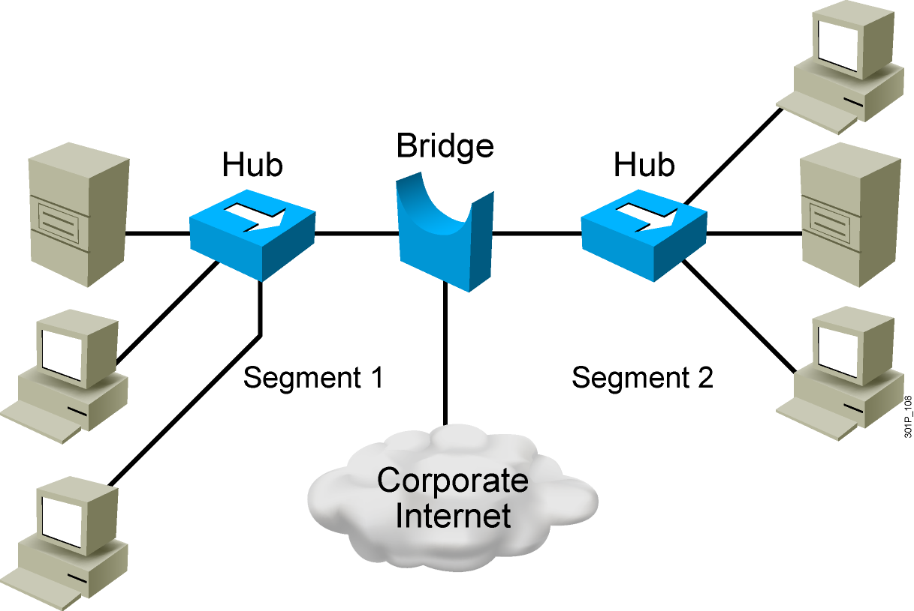
Bridges
Operate at Layer 2 of the OSI model
Forward, filter, or flood frames
Have few ports
Are slow

Slide 18
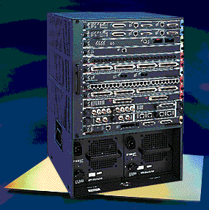
LAN Switch
High port density
Large frame buffers
Mixture of port speeds
Fast internal switching
Switching modes:
Cut-through
Store-and-forward
Fragment-free
Notes:
Lesson Aim
<Enter lesson aim here.>

Slide 19
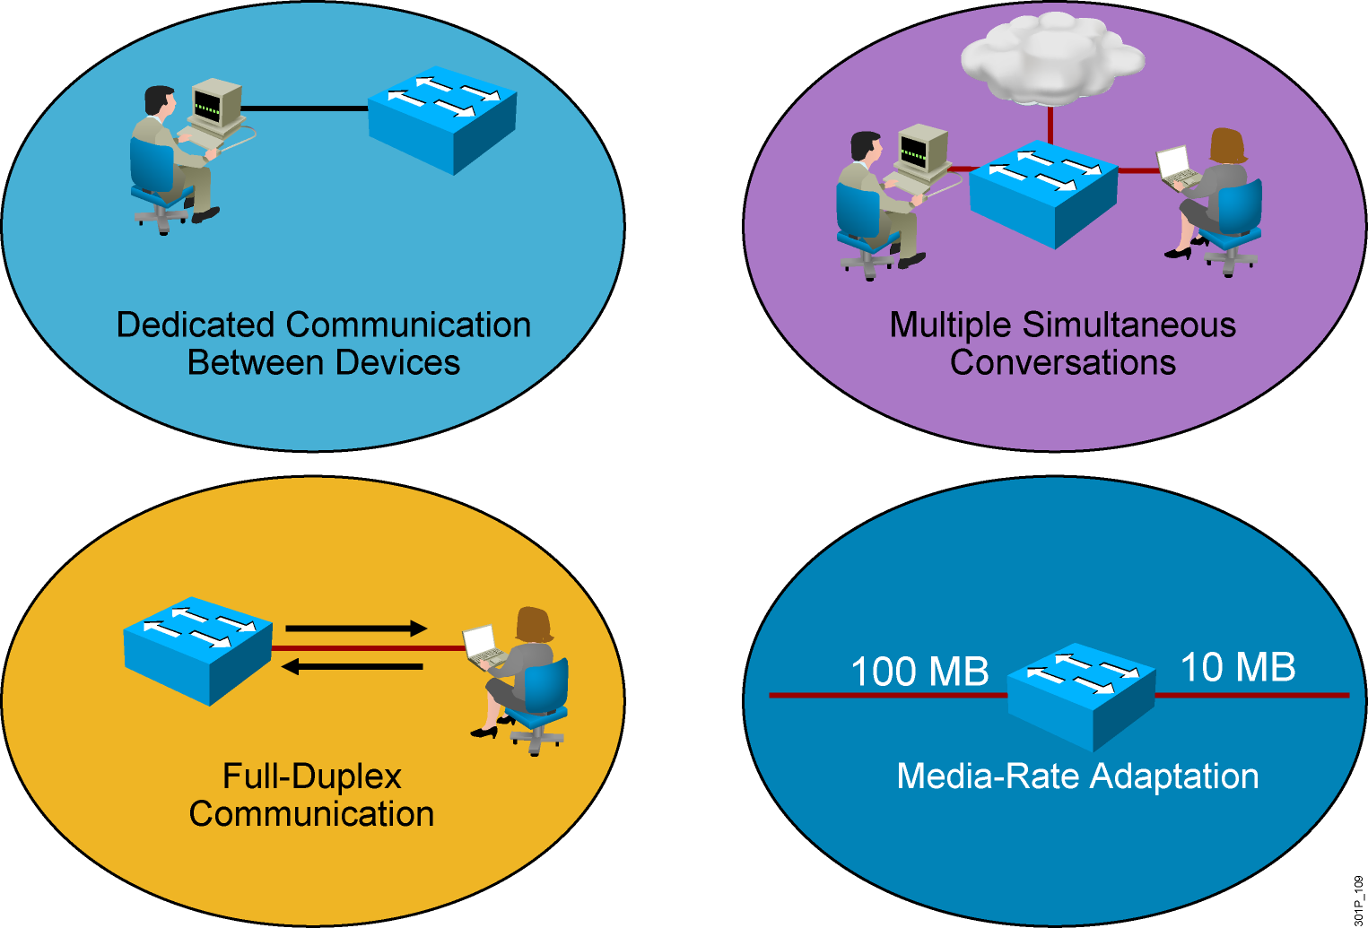
LAN Switch Features
Notes:
Lesson Aim
<Enter lesson aim here.>

Slide 20
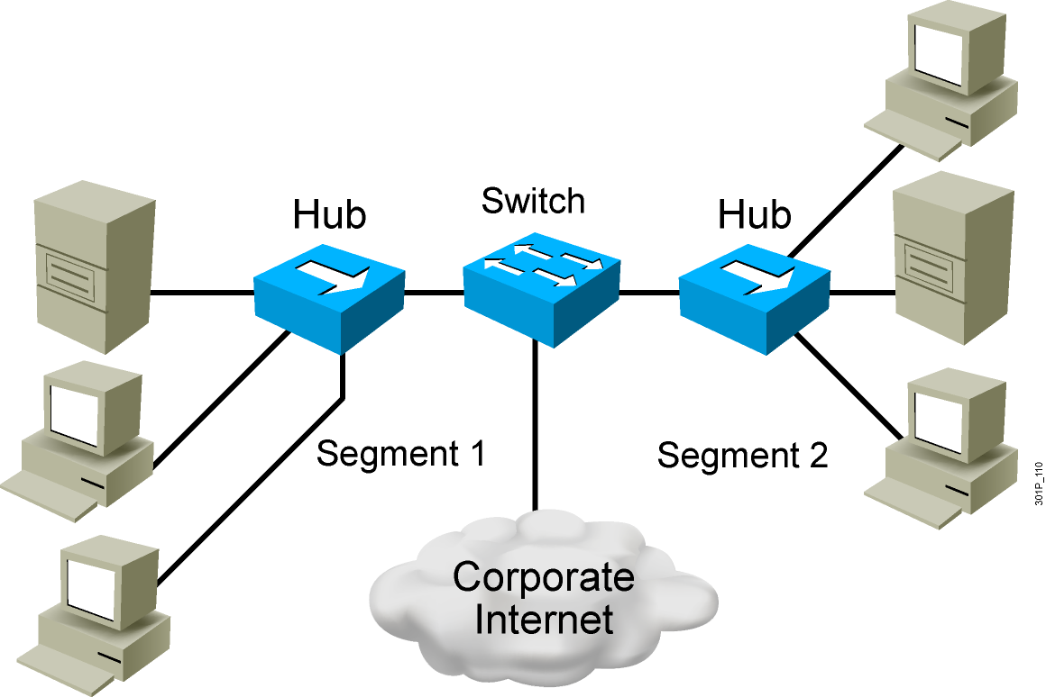
Switches Supersede Bridges
Operate at Layer 2 of the OSI model
Forward, filter, or flood frames
Have many ports
Are fast

Slide 21
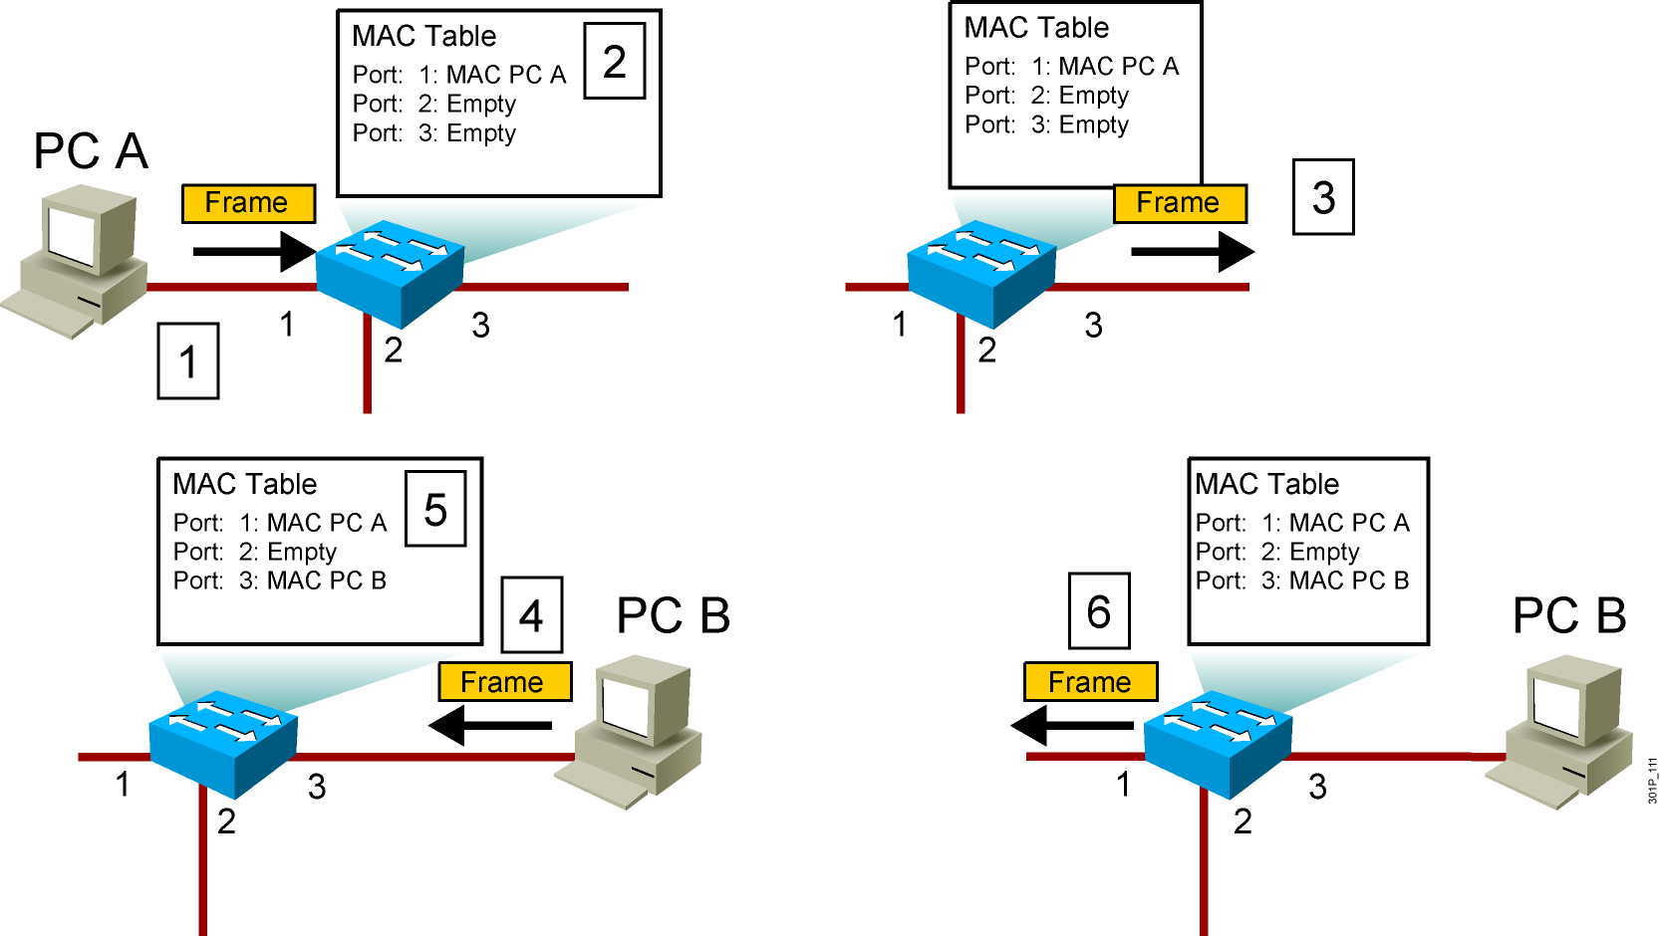
Switching Frames
Notes:
Lesson Aim
<Enter lesson aim here.>

Slide 22
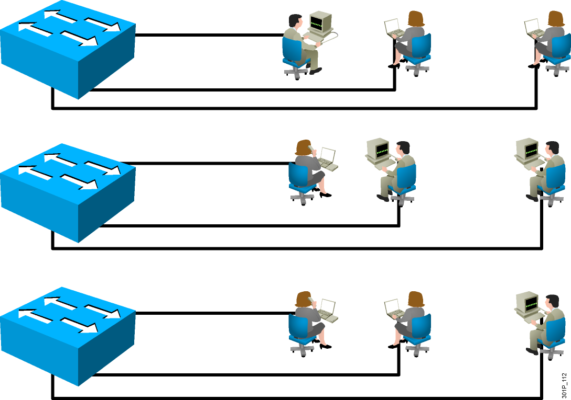
LANs Today
Users grouped by physical location
More switches added to networks
Switches connected by high-speed links

Slide 23
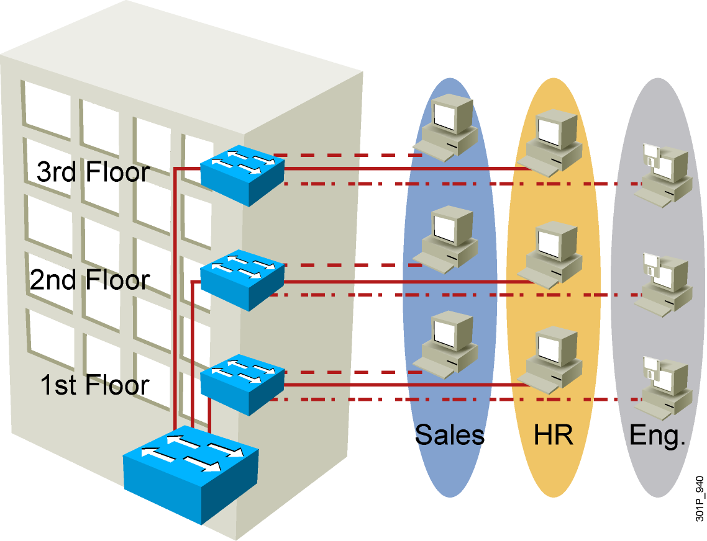
VLAN Overview
Segmentation
Flexibility
Security
VLAN = Broadcast Domain = Logical Network (Subnet)
Notes:
Purpose:
Emphasize: A VLAN is a broadcast domain.
Note: In order to have inter-VLAN communications, a router is required.

Slide 24
III. Exploring the packet Delivery Process 1 (layer 1)

Slide 25
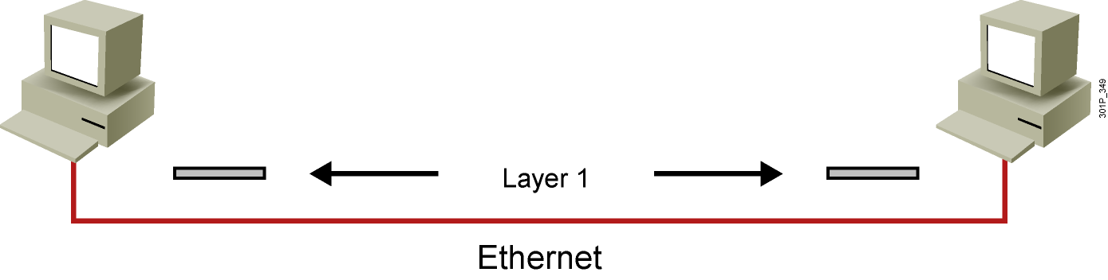
Layer 1 Devices
Layer 1 provides the physical media and its encoding.
Examples:
Ethernet
Serial
Repeater
Physical interface of the NIC
Notes:
Lesson Aim
<Enter lesson aim here.>

Slide 26
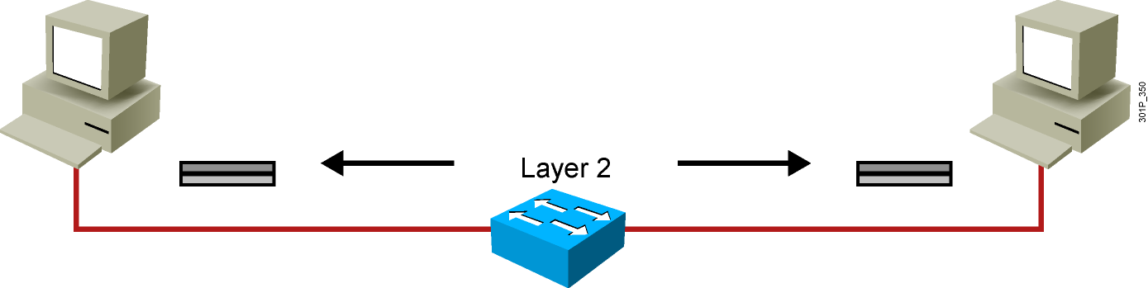
Layer 2 Devices
Layer 2 devices provide an interface with the physical media.
Examples:
NIC
Bridge
Switch
Notes:
Lesson Aim
<Enter lesson aim here.>

Slide 27
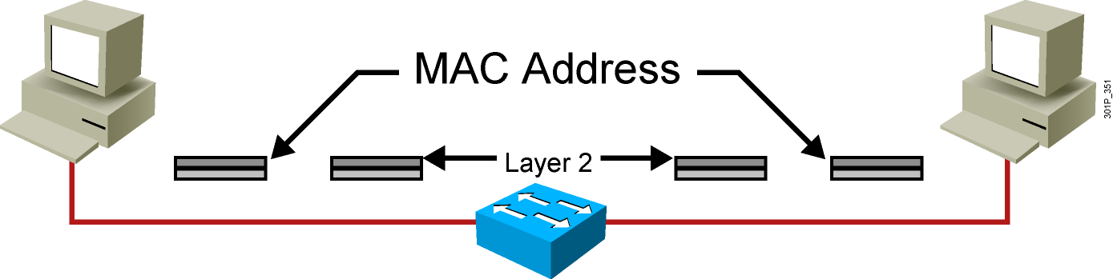
Layer 2 Addressing
MAC address
Assigned to end devices
Notes:
Lesson Aim
<Enter lesson aim here.>

Slide 28
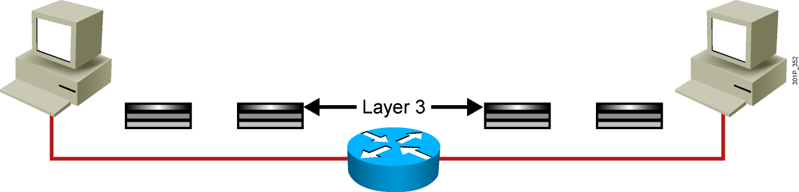
Layer 3 Devices and Their Function
The network layer provides connectivity and path selection between two host systems.
In the host, this is the path between the data link layer and the upper layers of the NOS.
In the router, it is the actual path across the network.
Notes:
Lesson Aim
<Enter lesson aim here.>

Slide 29
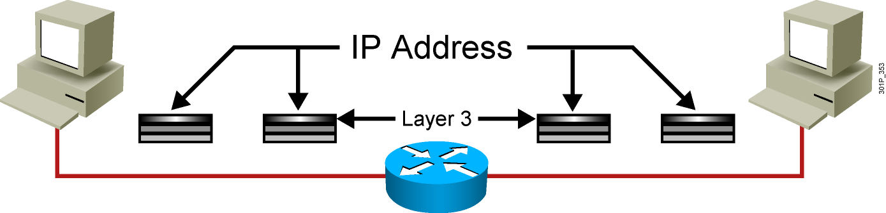
Layer 3 Addressing
Each NOS has its own Layer 3 address format.
OSI uses an NSAP.
TCP/IP uses IP.
Notes:
Lesson Aim
<Enter lesson aim here.>

Slide 30
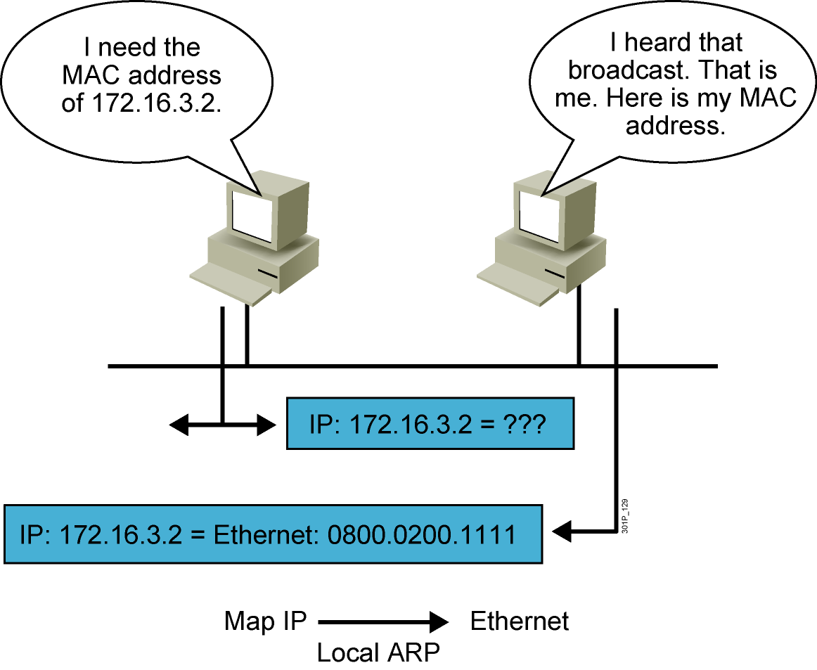
ARP
Notes:
Lesson Aim
<Enter lesson aim here.>

Slide 31
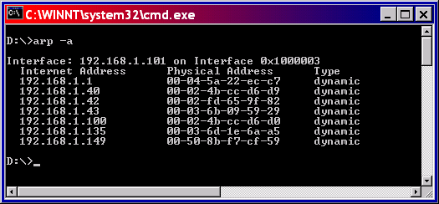
ARP Table

Slide 32
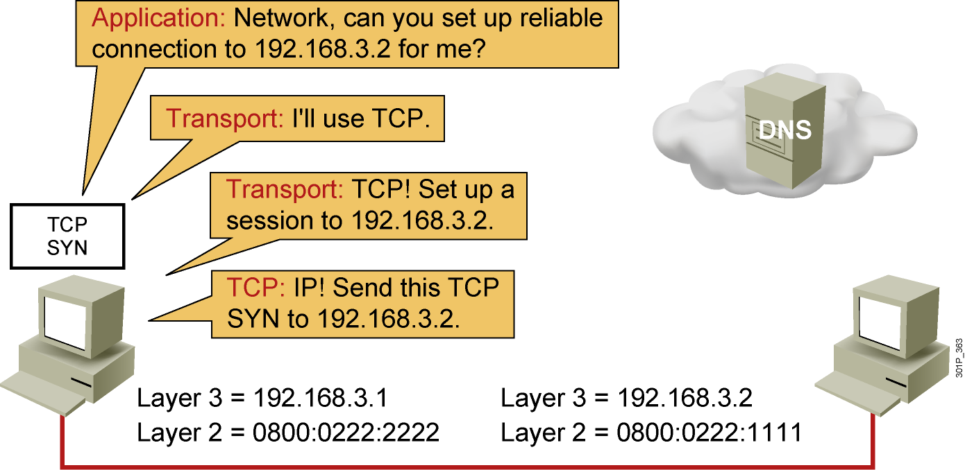
Host-to-Host Packet Delivery (1 of 22)
Notes:
Lesson Aim
<Enter lesson aim here.>

Slide 33
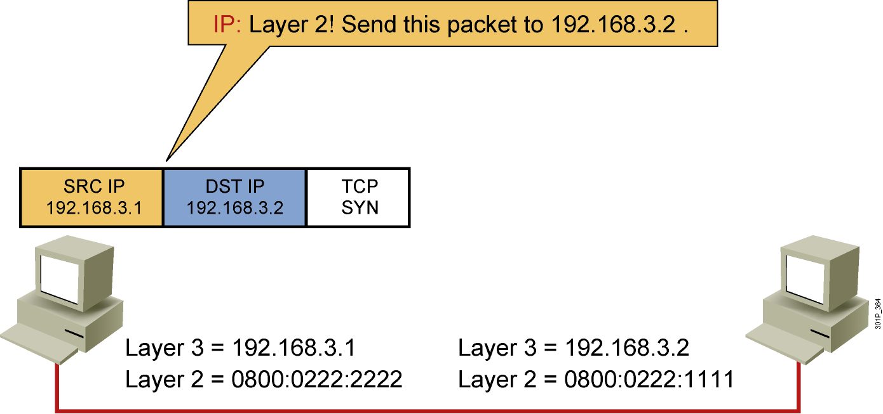
Host-to-Host Packet Delivery (2 of 22)
Notes:
Lesson Aim
<Enter lesson aim here.>

Slide 34
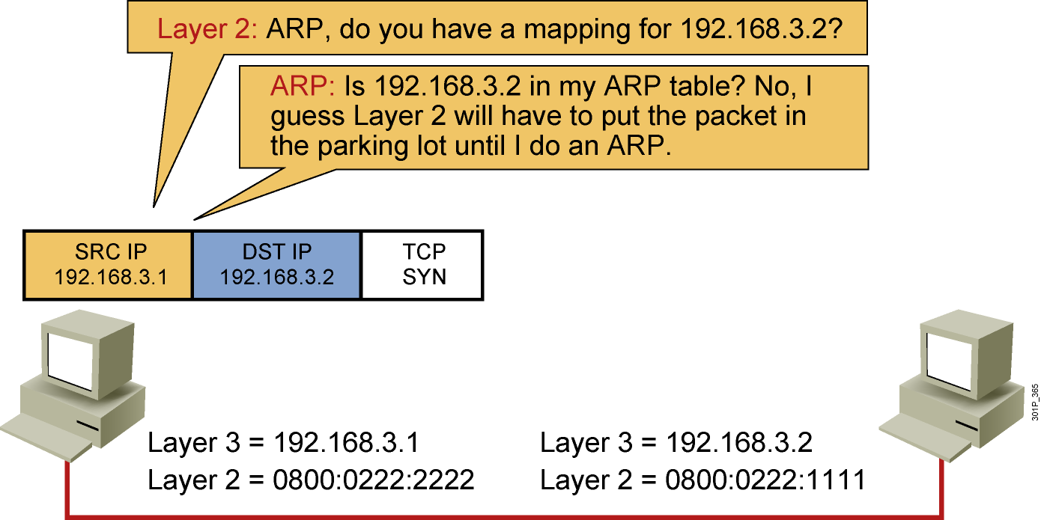
Host-to-Host Packet Delivery (3 of 22)
Notes:
Lesson Aim
<Enter lesson aim here.>

Slide 35
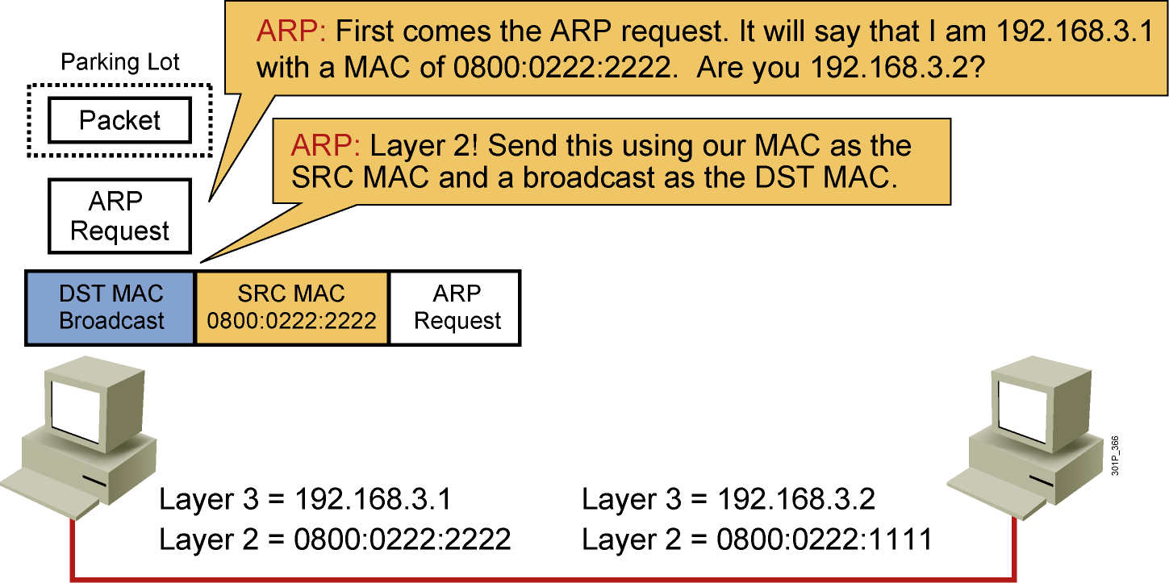
Host-to-Host Packet Delivery (4 of 22)
Notes:
Lesson Aim
<Enter lesson aim here.>

Slide 36
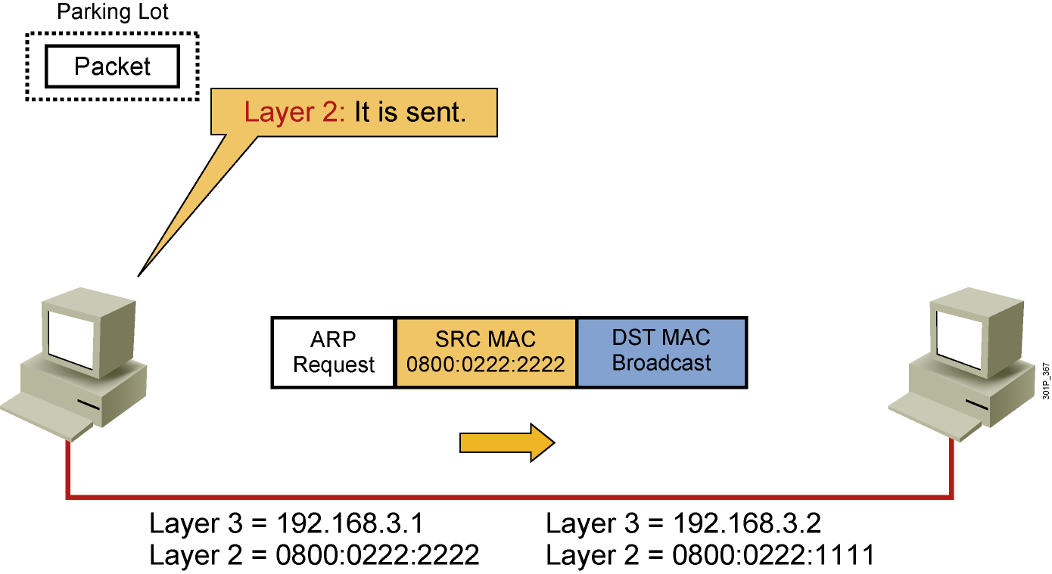
Host-to-Host Packet Delivery (5 of 22)
Notes:
Lesson Aim
<Enter lesson aim here.>

Slide 37
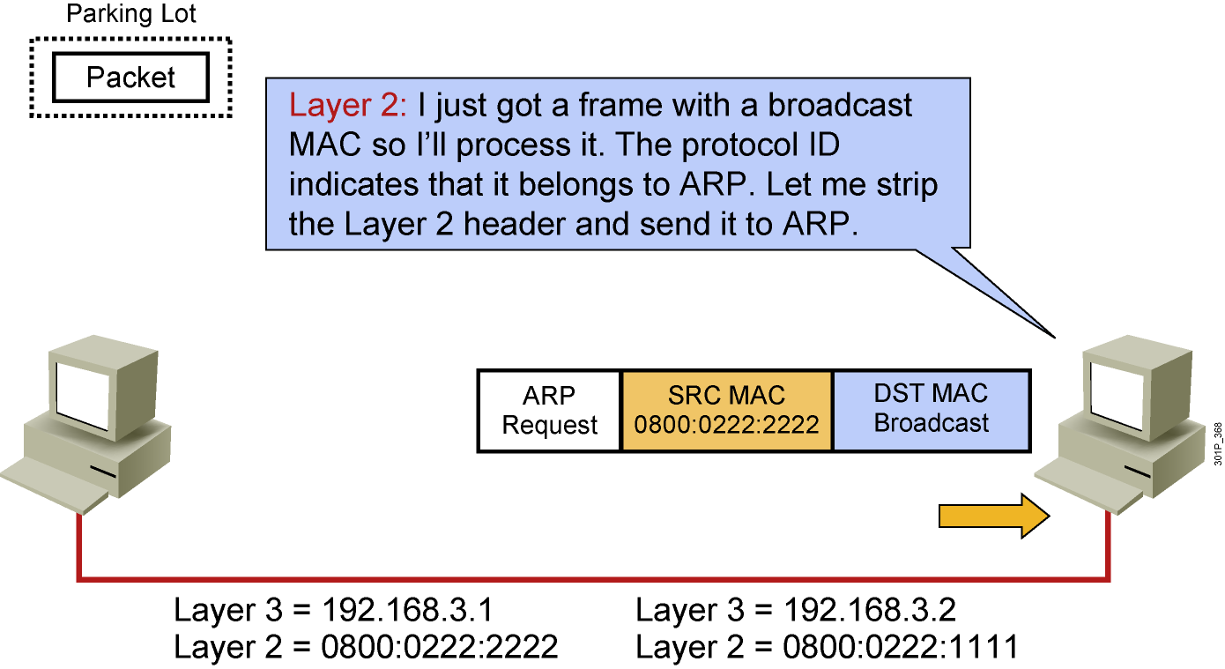
Host-to-Host Packet Delivery (6 of 22)
Notes:
Lesson Aim
<Enter lesson aim here.>

Slide 38
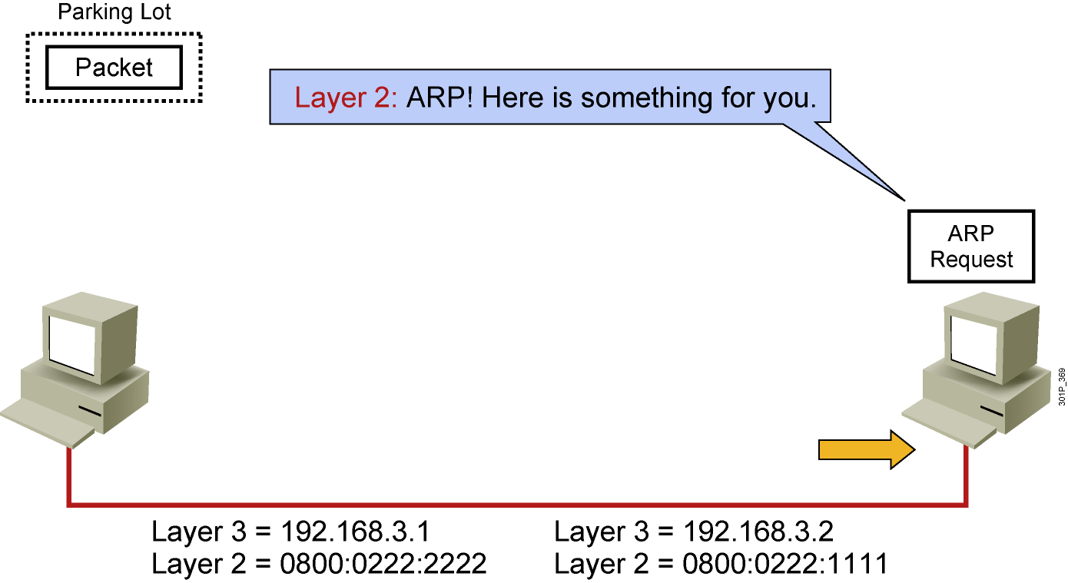
Host-to-Host Packet Delivery (7 of 22)
Notes:
Lesson Aim
<Enter lesson aim here.>

Slide 39
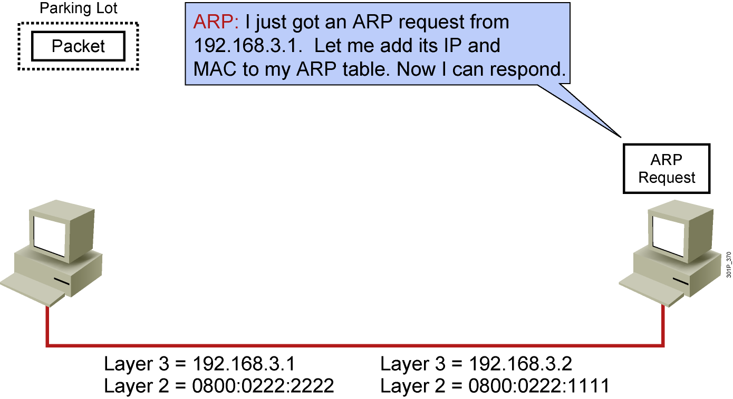
Host-to-Host Packet Delivery (8 of 22)
Notes:
Lesson Aim
<Enter lesson aim here.>

Slide 40
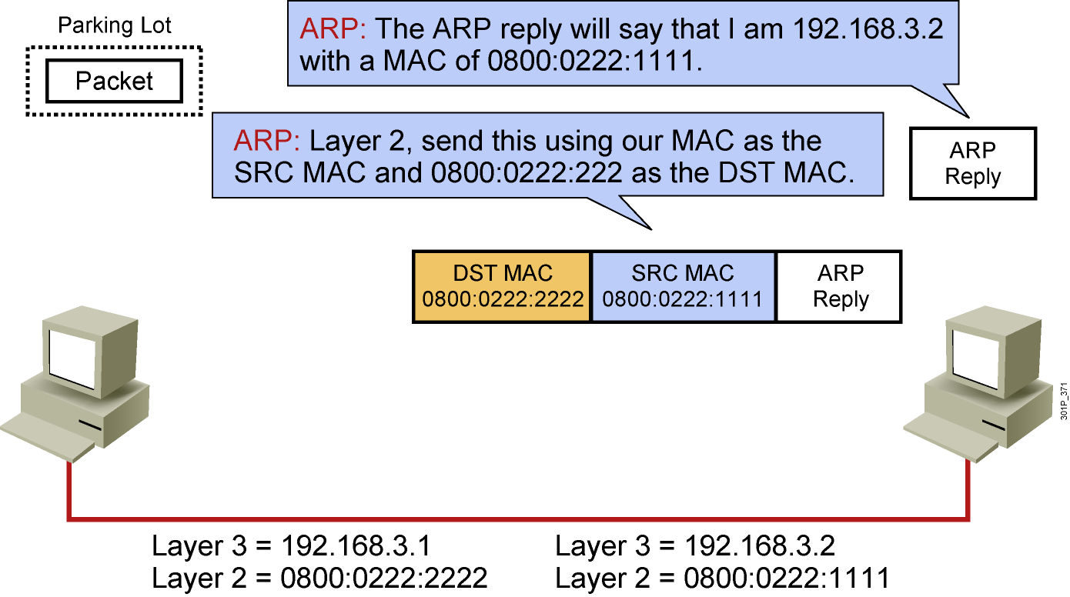
Host-to-Host Packet Delivery (9 of 22)
Notes:
Lesson Aim
<Enter lesson aim here.>

Slide 41
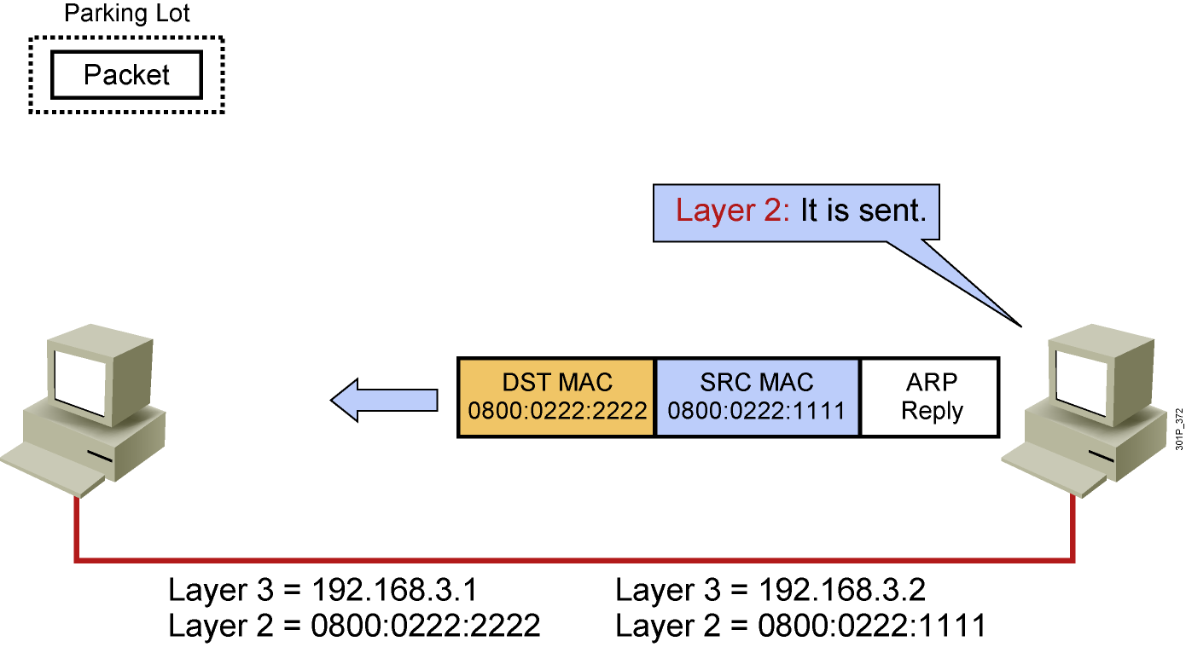
Host-to-Host Packet Delivery (10 of 22)
Notes:
Lesson Aim
<Enter lesson aim here.>

Slide 42
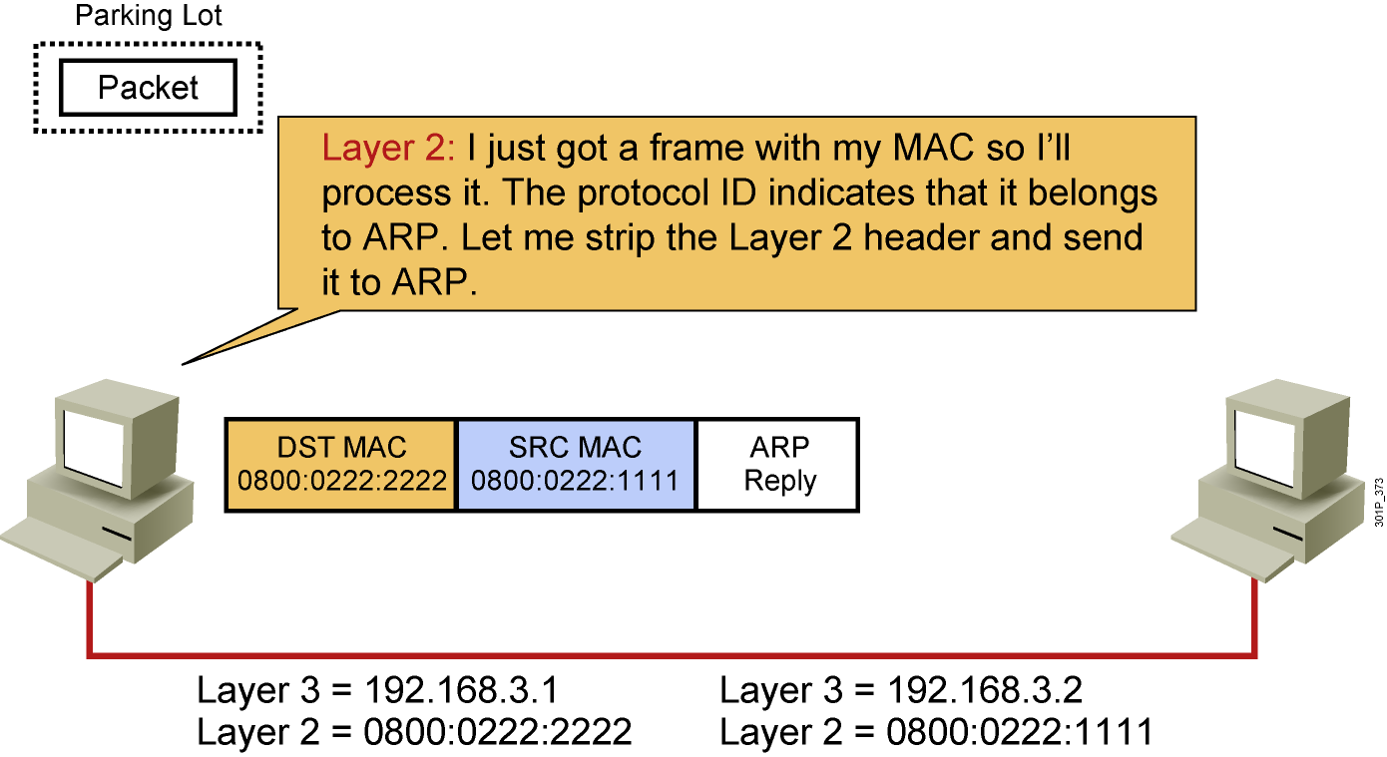
Host-to-Host Packet Delivery (11 of 22)
Notes:
Lesson Aim
<Enter lesson aim here.>

Slide 43
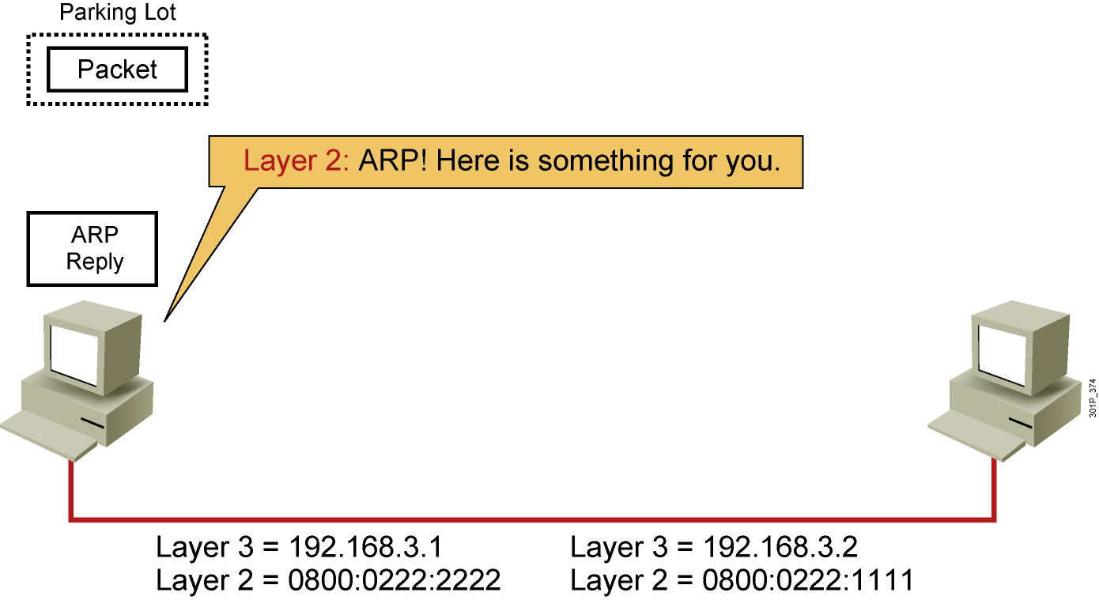
Host-to-Host Packet Delivery (12 of 22)
Notes:
Lesson Aim
<Enter lesson aim here.>

Slide 44
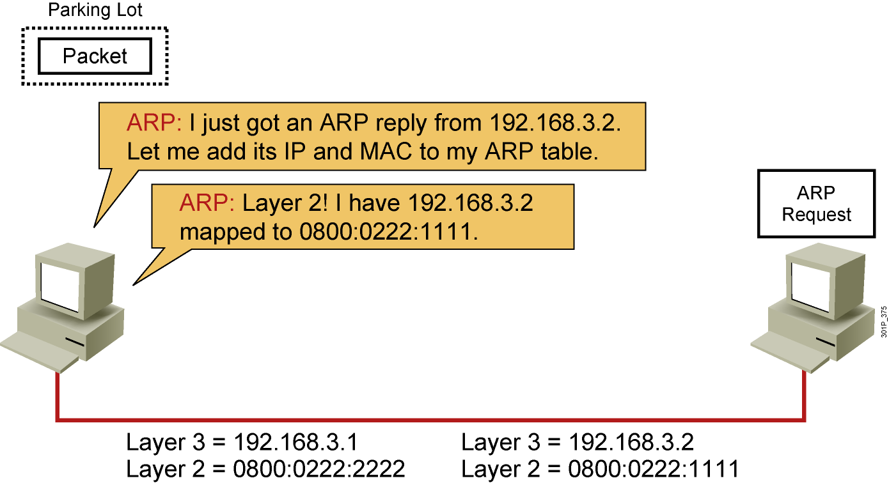
Host-to-Host Packet Delivery (13 of 22)
Notes:
Lesson Aim
<Enter lesson aim here.>

Slide 45
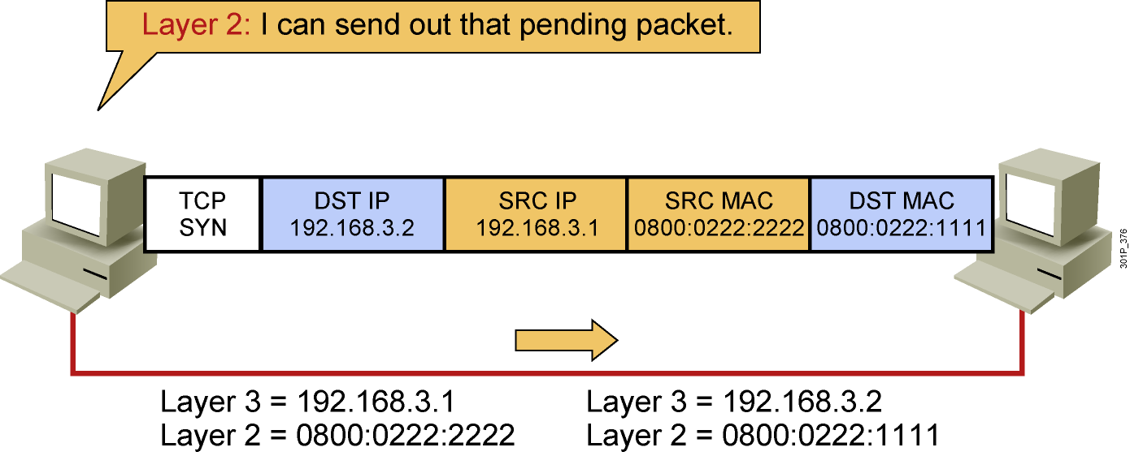
Host-to-Host Packet Delivery (14 of 22)
Notes:
Lesson Aim
<Enter lesson aim here.>

Slide 46
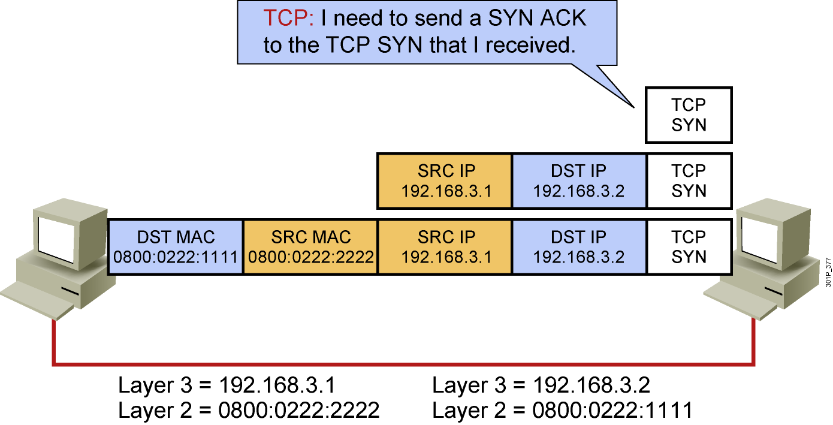
Host-to-Host Packet Delivery (15 of 22)
Notes:
Lesson Aim
<Enter lesson aim here.>

Slide 47
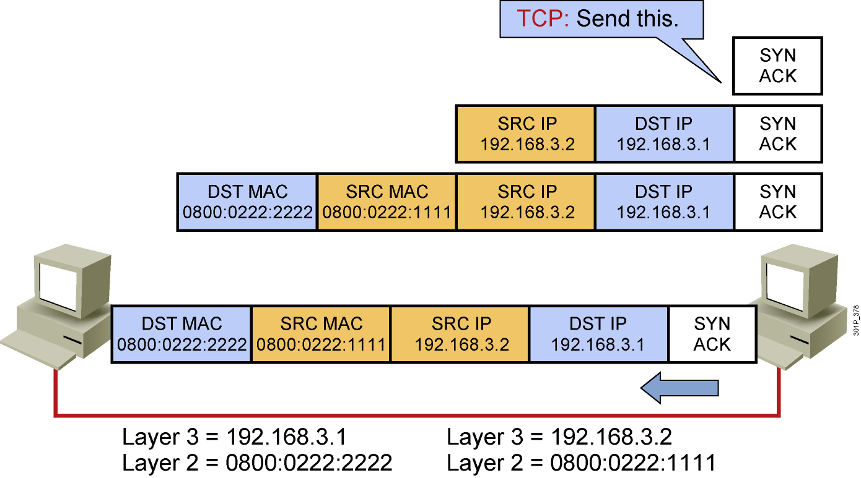
Host-to-Host Packet Delivery (16 of 22)
Notes:
Lesson Aim
<Enter lesson aim here.>

Slide 48
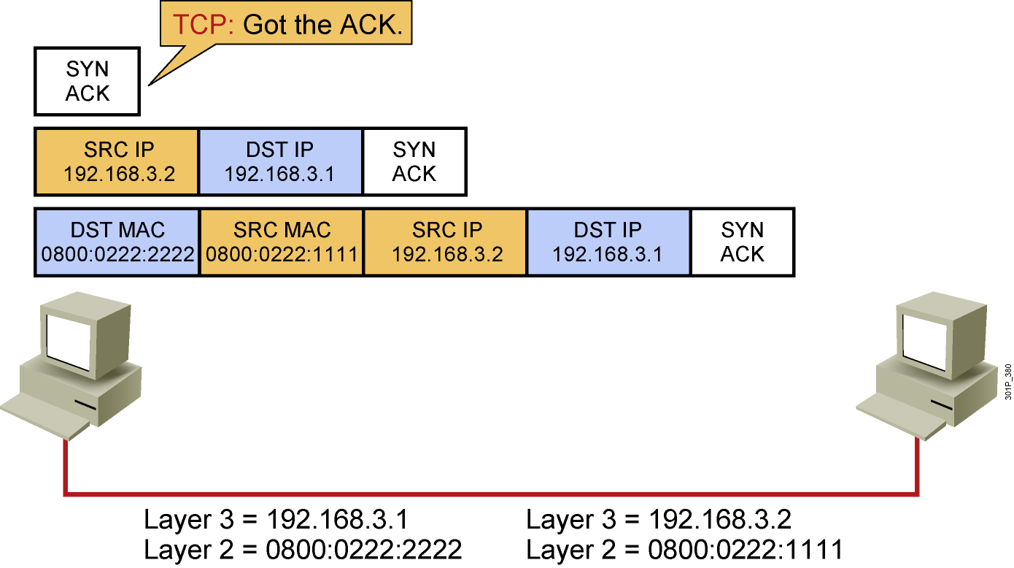
Host-to-Host Packet Delivery (17 of 22)
Notes:
Lesson Aim
<Enter lesson aim here.>

Slide 49
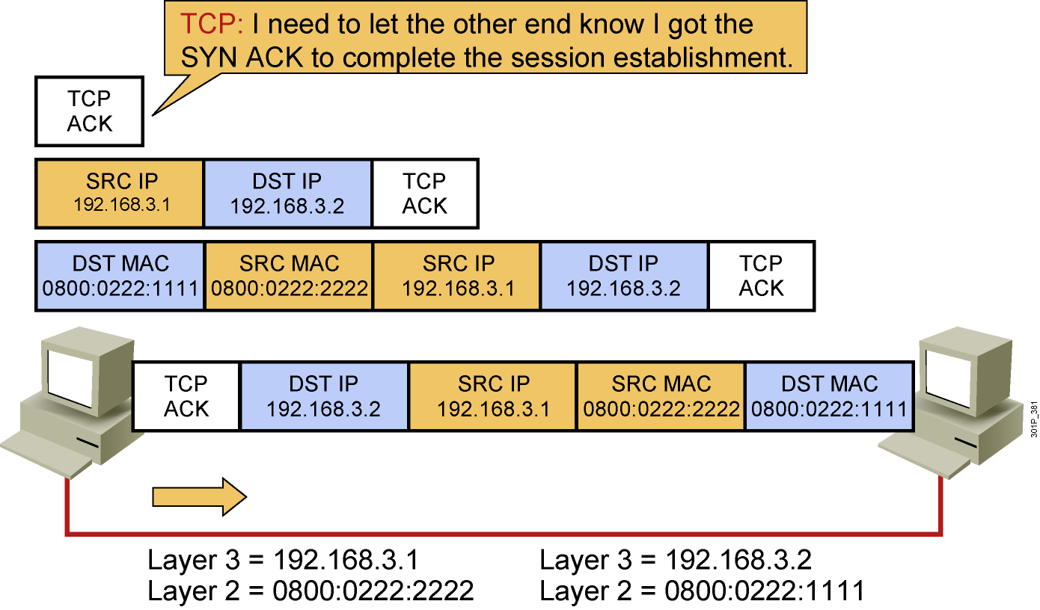
Host-to-Host Packet Delivery (18 of 22)
Notes:
Lesson Aim
<Enter lesson aim here.>

Slide 50
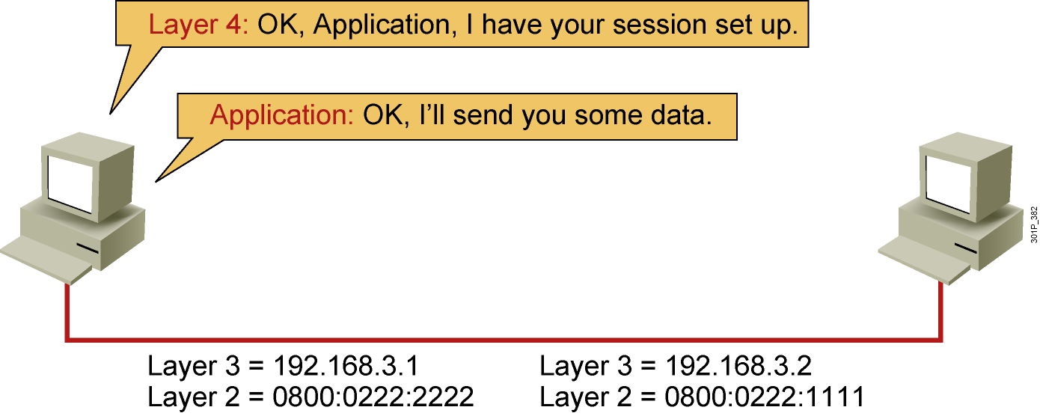
Host-to-Host Packet Delivery (19 of 22)
Notes:
Lesson Aim
<Enter lesson aim here.>

Slide 51
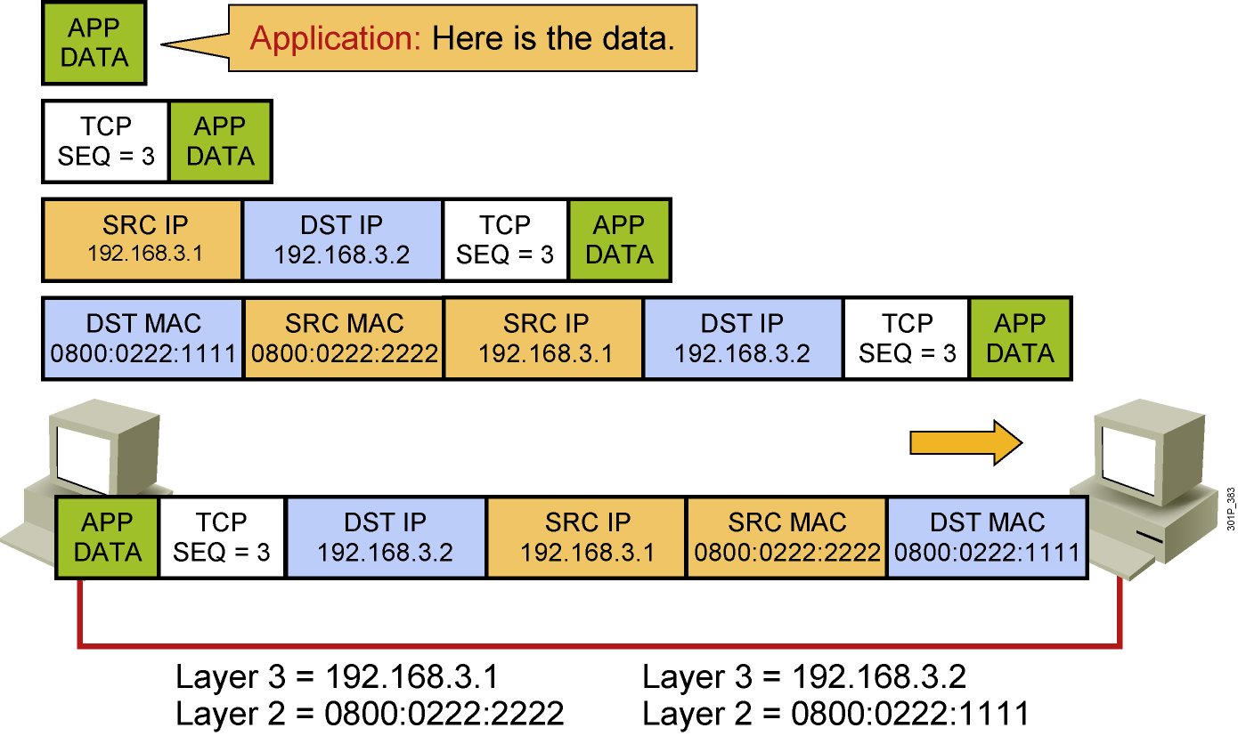
Host-to-Host Packet Delivery (20 of 22)
Notes:
Lesson Aim
<Enter lesson aim here.>

Slide 52
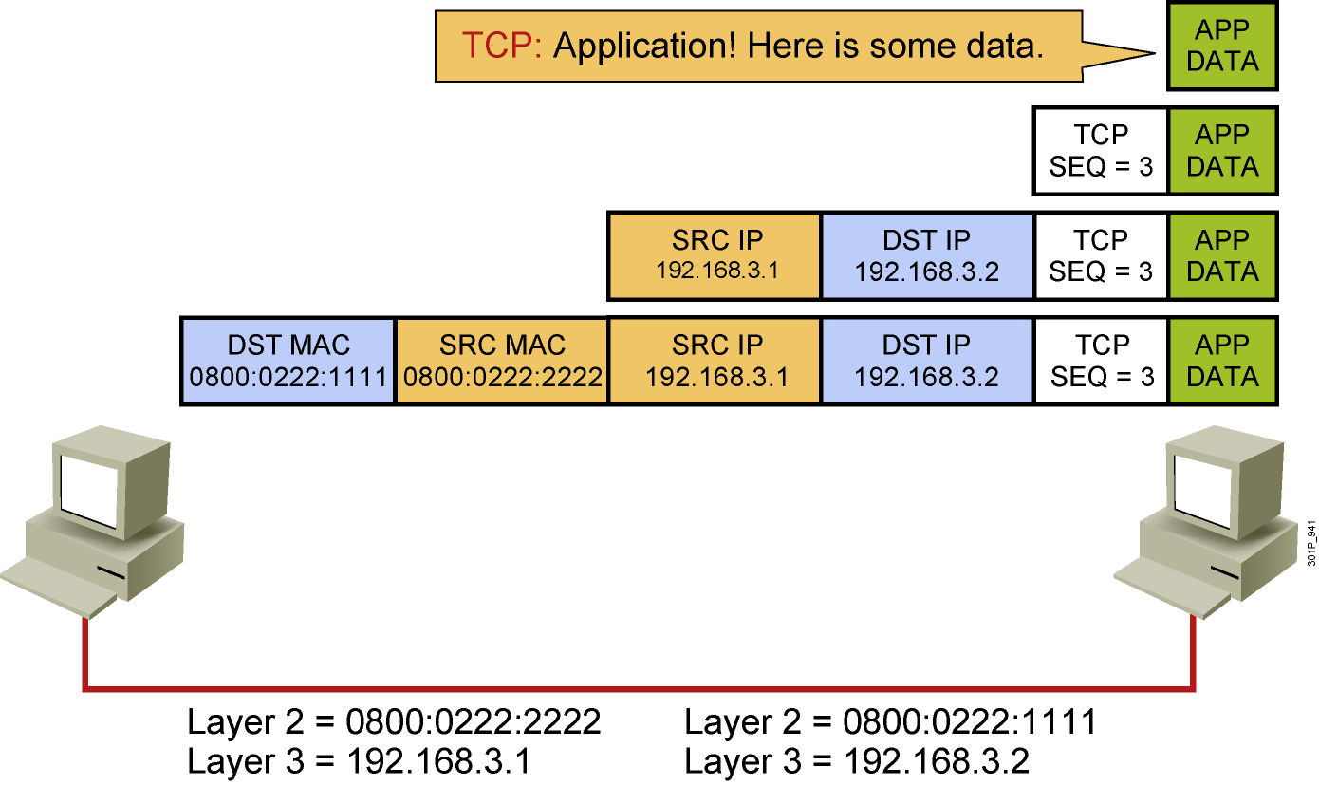
Host-to-Host Packet Delivery (21 of 22)
Notes:
Lesson Aim
<Enter lesson aim here.>

Slide 53
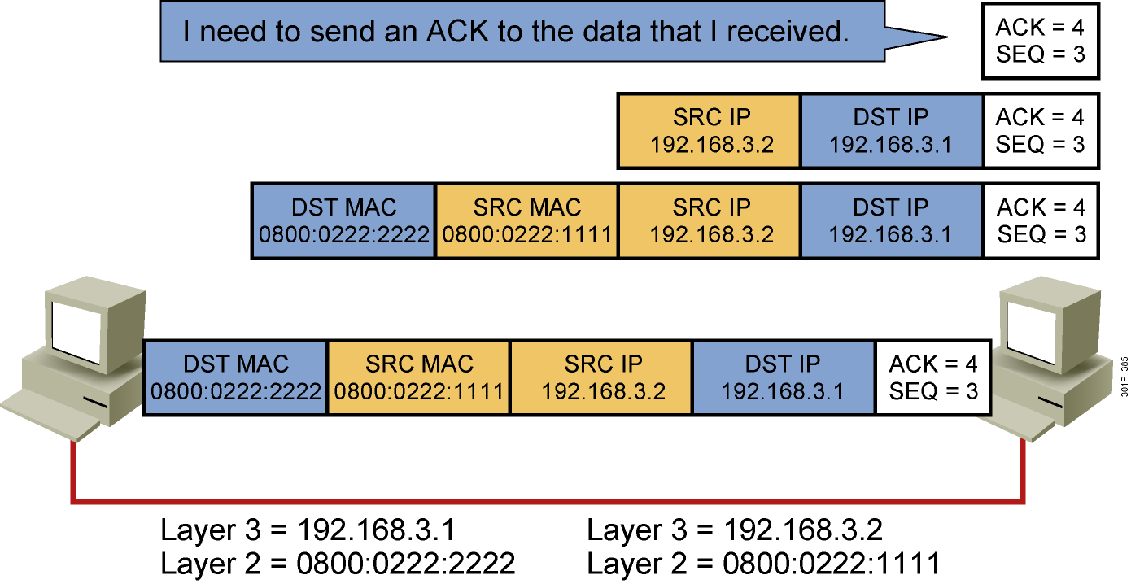
Host-to-Host Packet Delivery (22 of 22)
Notes:
Lesson Aim
<Enter lesson aim here.>

Slide 54
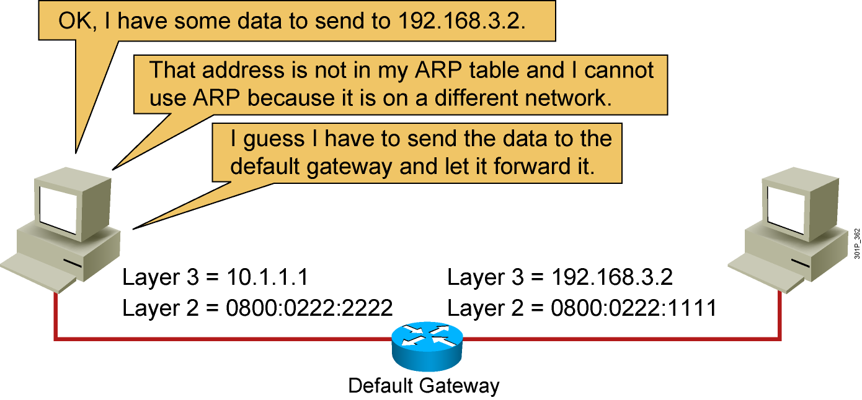
Default Gateway
Notes:
Lesson Aim
<Enter lesson aim here.>

Slide 55
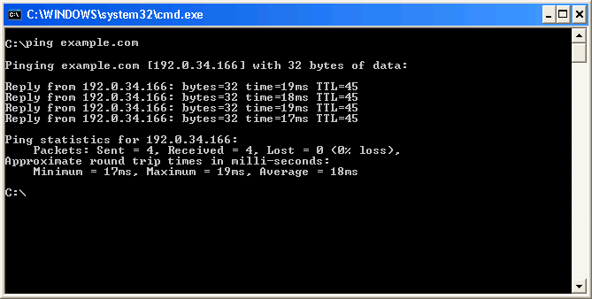
Host-Based Tools: ping

Slide 56
Host-Based Tools: Table

Slide 57
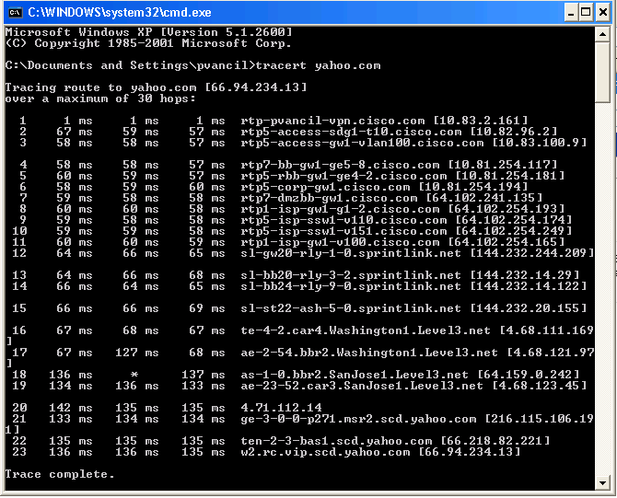
Host-Based Tools: tracert

Slide 58
IV. Exploring the packet Delivery Process 2 (layer 2)

Slide 59
Layer 2 Addressing
Uses MAC address
Assigned to end devices
Notes:
Lesson Aim
<Enter lesson aim here.>

Slide 60

Layer 3 Addressing
Each NOS has its own Layer 3 address format.
OSI uses NSAP.
TCP/IP uses IP.
Notes:
Lesson Aim
<Enter lesson aim here.>

Slide 61

Host-to-Host Packet Delivery (1 of 10)
Notes:
Lesson Aim
<Enter lesson aim here.>

Slide 62

Host-to-Host Packet Delivery (2 of 10)
Notes:
Lesson Aim
<Enter lesson aim here.>

Slide 63

Host-to-Host Packet Delivery (3 of 10)
Notes:
Lesson Aim
<Enter lesson aim here.>

Slide 64

Host-to-Host Packet Delivery (4 of 10)
Notes:
Lesson Aim
<Enter lesson aim here.>

Slide 65

Host-to-Host Packet Delivery (5 of 10)
Notes:
Lesson Aim
<Enter lesson aim here.>

Slide 66

Host-to-Host Packet Delivery (6 of 10)
Notes:
Lesson Aim
<Enter lesson aim here.>

Slide 67

Host-to-Host Packet Delivery (7 of 10)
Notes:
Lesson Aim
<Enter lesson aim here.>

Slide 68

Host-to-Host Packet Delivery (8 of 10)
Notes:
Lesson Aim
<Enter lesson aim here.>

Slide 69

Host-to-Host Packet Delivery (9 of 10)
Notes:
Lesson Aim
<Enter lesson aim here.>

Slide 70

Host-to-Host Packet Delivery (10 of 10)
Notes:
Lesson Aim
<Enter lesson aim here.>

Slide 71
V. Exploring the packet Delivery Process 3 (layer 3)

Slide 72

Layer 2 Addressing
Notes:
Lesson Aim
<Enter lesson aim here.>

Slide 73

Layer 3 Addressing
Notes:
Lesson Aim
<Enter lesson aim here.>

Slide 74

Host-to-Host Packet Delivery (1 of 17)
Notes:
Lesson Aim
<Enter lesson aim here.>

Slide 75

Host-to-Host Packet Delivery (2 of 17)
Notes:
Lesson Aim
<Enter lesson aim here.>

Slide 76

Host-to-Host Packet Delivery (3 of 17)
Notes:
Lesson Aim
<Enter lesson aim here.>

Slide 77

Host-to-Host Packet Delivery (4 of 17)
Notes:
Lesson Aim
<Enter lesson aim here.>

Slide 78

Host-to-Host Packet Delivery (5 of 17)
Notes:
Lesson Aim
<Enter lesson aim here.>

Slide 79

Host-to-Host Packet Delivery (6 of 17)
Notes:
Lesson Aim
<Enter lesson aim here.>

Slide 80

Host-to-Host Packet Delivery (7 of 17)
Notes:
Lesson Aim
<Enter lesson aim here.>

Slide 81

Host-to-Host Packet Delivery (8 of 17)
Notes:
Lesson Aim
<Enter lesson aim here.>

Slide 82

Host-to-Host Packet Delivery (9 of 17)
Notes:
Lesson Aim
<Enter lesson aim here.>

Slide 83

Host-to-Host Packet Delivery (10 of 17)
Notes:
Lesson Aim
<Enter lesson aim here.>

Slide 84

Host-to-Host Packet Delivery (11 of 17)
Destination | Next Hop | Interface
192.168.3.0/24 | Connected | fa 0/0
192.168.4.0/24 | Connected | fa 0/1
Notes:
Lesson Aim
<Enter lesson aim here.>

Slide 85
Host-to-Host Packet Delivery (12 of 17)
Notes:
Lesson Aim
<Enter lesson aim here.>

Slide 86

Host-to-Host Packet Delivery (13 of 17)
Notes:
Lesson Aim
<Enter lesson aim here.>

Slide 87

Host-to-Host Packet Delivery (14 of 17)
Notes:
Lesson Aim
<Enter lesson aim here.>

Slide 88

Host-to-Host Packet Delivery (15 of 17)
Notes:
Lesson Aim
<Enter lesson aim here.>

Slide 89

Host-to-Host Packet Delivery (16 of 17)
Notes:
Lesson Aim
<Enter lesson aim here.>

Slide 90

Host-to-Host Packet Delivery (17 of 17)
Notes:
Lesson Aim
<Enter lesson aim here.>

Slide 91
????

